Slide 1
Discussion 2 - Higher Order Functions
Chris Allsman (they/them)
Section 120

Slide 2
Agenda
Administrivia
Finishing up Environment Diagram rules + practice
HOF codewriting?

Slide 3
Administrivia
Hog due tonight
Be sure to add partners!
Slip days available if needed
HW2 due 9/6
CSM adjunct sections open for signups - see Piazza, sign up by Friday
MT1 Monday 2/11!
No lab next week

Slide 4
Call Expressions
Follow the golden rules of evaluation:
Evaluate operator
Evaluate operands
Apply operator to operands
Call expressions create new frames!

Slide 5
Creating frames
Give frame a unique label (f1, f2, f3)
Label the frame with the function’s intrinsic name (the name from the def statement) if it exists
Label it with the parent (defined earlier)

Slide 6
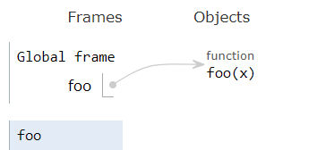
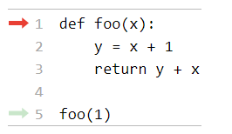
Example:
f1
[P = G]

Slide 7
Call Expressions
After creating frame:
Bind parameters to arguments (what you pass in)
Evaluate body using the earlier rules
At end, be sure to put the return value (by default, None)

Slide 8
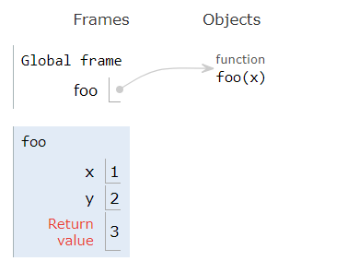
Example:
[P = G]
f1

Slide 9
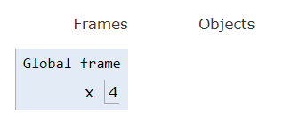

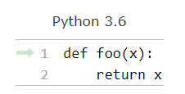
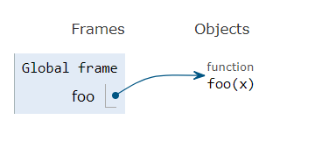
Assignment Statements:
Call Expressions:
Evaluate RHS
Make binding in current frame
Def Statements:
[P = G]
Label w/ index, name, parent
f1
[P = G]
[P = G]
Bind arguments to parameters
Don’t go into body yet
Make binding in current frame
Return something

Slide 10
Assignment Statements:
Call Expressions:
Evaluate RHS
Make binding in current frame
Def Statements:
[P = G]
Label w/ index, name, parent
f1
[P = G]
[P = G]
Bind arguments to parameters
Don’t go into body yet
Make binding in current frame
Return something

Slide 11
Lookups
When trying to find the value of a variable:
If it’s in your current frame, great!
If not, look in the parent of your frame, then in your parent’s parent, and so on
If there are no more parents (you’re in the global frame), it doesn’t exist!

Slide 12
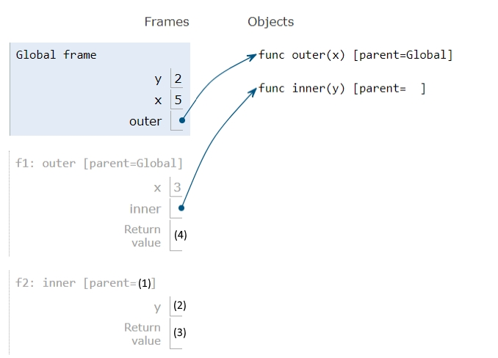
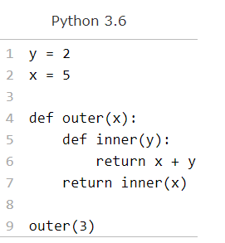

Slide 13
(1) f1

Slide 14
(1) f1
(2) 3

Slide 15
(1) f1
(2) 3
(3) 6

Slide 16
(1) f1
(2) 3
(3) 6
(4) 6

Slide 17
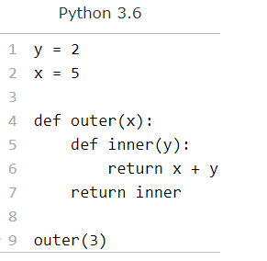
What does the environment diagram look like now?

Slide 18
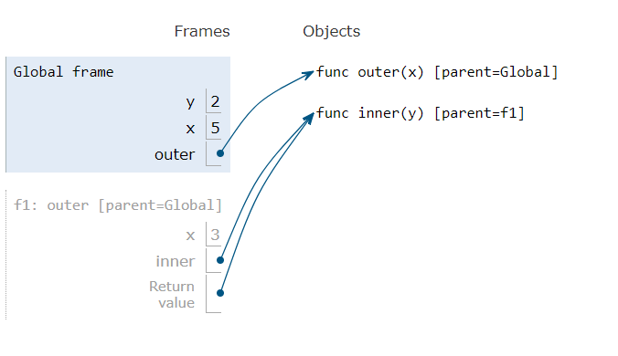
What does the environment diagram look like now?
Don’t call inner, so we just return a function value

Slide 19
Function Values
Executing a def statement or evaluating a lambda creates a function value
Function values = a value that can be called later
The result of calling a function value is what that function returns
But a function value doesn’t access its body until called!

Slide 20
Review: Lambdas
Expressions that evaluate to function values
Don’t access their return values until you call them
Bodies only have a single expression that you return
Don’t have an intrinsic name

Slide 21
Review: Lambdas
lambda x, y: x + y

Slide 22
Review: Lambdas
lambda x, y: x + y
Takes in parameters x + y

Slide 23
Review: Lambdas
lambda x, y: x + y
When called, returns x plus y

Slide 24
Lambdas in Environment Diagrams
(lambda x, y: x + y)(1, 2)

Slide 25
Lambdas in Environment Diagrams
(lambda x, y: x + y)(1, 2)
Evaluate operator to get a function value

Slide 26
Lambdas in Environment Diagrams
(lambda x, y: x + y)(1, 2)
Evaluate each operand

Slide 27
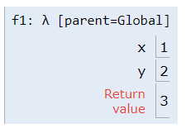
Lambdas in Environment Diagrams
(lambda x, y: x + y)(1, 2)
Create a new frame, no intrinsic name. Parent is where lambda was evaluated

Slide 28
Lambdas in Environment Diagrams
(lambda x, y: x + y)(1, 2)
Bind arguments to parameters, as before

Slide 29
Lambdas in Environment Diagrams
(lambda x, y: x + y)(1, 2)
Evaluate body of lambda and return that

Slide 30
A Note: HOFs
Higher order functions (HOFs) either take in a function value or return a function value
We just did an example of this!
Pay attention to return types and input types
Does a function return another function?
If so, how many parameters for that function? What does that function return?

Slide 31
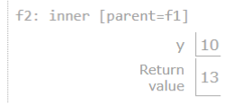

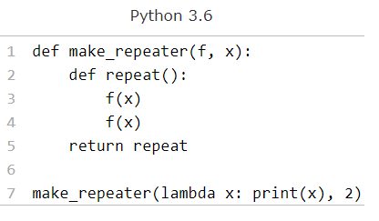
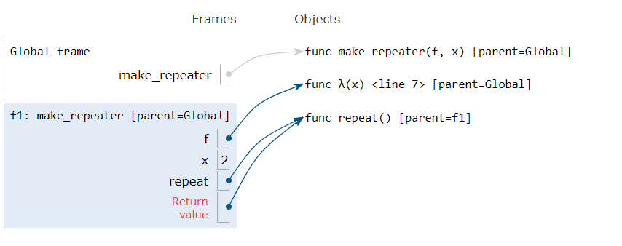
Lookups
HOFs
Take in a function value or return one
To find the value of a variable not in current frame, look in parent frame
Lambdas
Evaluates to a function value
lambda x, y: x + y
parameters
Expression returned (after evaluating)
Remember: copy pointers to functions

Slide 32

Attendance!
links.cs61a.org/chris-disc
Magic Word: curry

Slide 33
Other links
links.cs61a.org/chris-intro if this is your first section with me
links.cs61a.org/chris-questions if you have questions on lecture
links.cs61a.org/chris-feedback if you have any (anonymous) feedback you want to give
Or just want to say something privately

Slide 34

Midterm Tips

Slide 35
Study Strategy
Check out some tips on piazza
Next day/two: focus on HW, Hog.
Review discussion worksheets and lectures for topics that still don’t make sense

Slide 36
Taking Midterms
HW/Projects/Discussions are great for familiarizing you with the material
The only way to prep for the midterm is to practice midterm-level questions
That being said…
Focus on the quality of your studying, not the number of tests you take

Slide 37
How I Practice Midterms
Take your first midterm blind
Don’t worry if you’re unprepared
Don’t take it with the textbook/lecture notes open
Don’t worry if you feel like you didn’t get anything
After you’ve spent at least 10-15 min on every problem:
Debrief each question. What did you know? What didn’t you know?
Take notes on it, and take some time to go back and study those areas

Slide 38
How I Practice Midterms
For each midterm you take, also identify areas that you struggle with, but also:
Build your cheat sheet. If you make same the mistake more than once, make sure to put it on there
When you look at the solutions, take some time to debrief. How could you get to this solution in the future? What in the skeleton/doctests would help you?

Slide 39
How I Practice Midterms
Don’t worry when you struggle with a problem
The dirty TA secret: we don’t actually know that much more than when we took the class
The most important thing is recognizing patterns and developing problem solving strategies
If you follow the previous suggestions, you’ll get better at these with each question you get through!

